Slide 1



Welcome to
CS 345 Operating Systems
Chapter 4 – Threads (09)

Slide 2
Tip #9: Standard Integer typedefs
The actual size of integer types varies by implementation.
The standard only requires size relations between the data types and minimum sizes for each data type, such that a long long is not smaller than long, which is not smaller than int, which is not smaller than short.
As char's size is always the minimum supported data type, no other data types (except bit-fields) can be smaller.
Starting with C99, the following pre-processor macros are defined in the header file <stdint.h>:
int8_t int16_t int32_t int64_t | signed integer type with width of exactly 8, 16, 32 and 64 bits respectively with no padding bits and using 2's complement for negative values (provided only if the implementation directly supports the type)
uint8_t uint16_t uint32_t uint64_t | unsigned integer type with width of exactly 8, 16, 32 and 64 bits respectively (provided only if the implementation directly supports the type)

Slide 3

Project 2: Tasking

Slide 4
Project 2: Multitasking
Contemporary operating systems are built around the concept of processes or tasks.
A task is an execution stream in the context of a particular task state.
Organizing system activities around tasks has proved to be a useful way of separating out different activities into coherent units.
To effectively utilize hardware resources, an operating system must interleave the execution of multiple tasks and still provide reasonable response times.
These tasks may or may not be related, should not directly affect the state of another task, but usually always need to share resources in a protected, prioritized, and equitable manner.

Slide 5
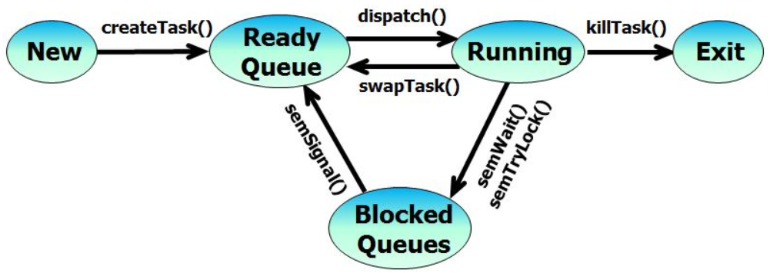
Project 2: Multitasking
Add a five-state task scheduler to your operating system capable of executing up to 128 tasks in a preemptive, prioritized, round-robin manner.
At any point in time, a task will be newly created, ready to run, running, blocked waiting for some event to occur, or exiting. A five-state task scheduler is illustrated as follows:

Slide 6

Step 1: Priority Queue
Create a priority queue
typedef int16_t TID; // task ID
typedef int16_t Priority; // task priority
typedef uint16_t* PQueue; // priority queue
Write queue functions to add/delete elements
TID enQ(PQueue q, TID tid, Priority p);
TID deQ(PQueue q, TID tid);
q -> (# | pr1/tid1 | pr2/tid2 | …)
tid >=0 find and delete tid from q
-1 return highest priority tid
TID tid (if found and deleted from q)
-1 (if q empty or task not found)
THOROUGHLY TEST BEFORE PROCEEDING!
•••
Priority/TID
Priority/TID
Priority/TID
Priority/TID
# of entries

Slide 7
Priority Queue
•••
Priority/TID
Priority/TID
Priority/TID
Priority/TID
# of entries
typedef struct
{ int16_t size;
struct
{ uint8_t tid;
uint8_t priority;
} pq[MAX_TASKS];
} PQ;
typedef uint16_t* PQ;
PQ* rq = (PQ*)malloc(sizeof(PQ));
rq->size = 1;
rq->pq[0].tid = tid;
rq->pq[0].priority = priority;
rq->pq[0] = rq->pq[1];
PQ rq = (PQ)malloc((MAX_TASKS+1) * sizeof(uint16_t));
rq[0] = 1;
rq[1] = (priority << 8) + tid;
rq[0] = rq[1];

Slide 8
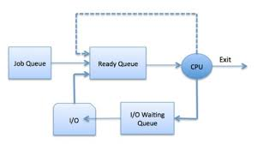
Step 2: Schedule w/Ready Queue
P2 - Tasking
rq[5]
rq[4] | 10 / 3
rq[3] | 5 / 2
rq[2] | 5 / 0
rq[1] | 2 / 1
rq[0] | 4
rq[5]
rq[4] | 10 / 3
rq[3] | 5 / 2
rq[2] | 5 / 0
rq[1] | 2 / 1
rq[0] | 4
Create a ready priority queue
typedef uint16_t* PQ; // priority queue
PQueue rq; // ready queue
rq = (int*)malloc(MAX_TASKS * sizeof(int));
rq[0] = 0; // init ready queue
Add new task to ready queue in createTask
enQ(rq, tid, tcb[tid].priority);
NOTE: priority = tcb[tid].priority
Change scheduler() to deQ/enQ next task
if ((tid = deQ(rq, -1)) >= 0)
{
enQ(rq, tid, tcb[tid].priority);
}

Slide 9
2-State Scheduler
enQ(rq, tid, tcb[tid].priority) in createTask
createTask()
dispatch()
killTask()
Ready
Queue
New
Running
Exit
swapTask()
if ((tid = deQ(rq, -1)) >= 0)
enQ(rq, tid, tcb[tid].priority);

Slide 10
Processes and Threads
Chapter 4

Slide 11
CS 345
Stalling’s Chapter | # | Project
1: Computer System Overview 2: Operating System Overview | 4 | P1: Shell
3: Process Description and Control 4: Threads | 4 | P2: Tasking
5: Concurrency: ME and Synchronization 6: Concurrency: Deadlock and Starvation | 6 | P3: Jurassic Park
7: Memory Management 8: Virtual memory | 6 | P4: Virtual Memory
9: Uniprocessor Scheduling 10: Multiprocessor and Real-Time Scheduling | 6 | P5: Scheduling
11: I/O Management and Disk Scheduling 12: File Management | 8 | P6: FAT
Student Presentations | 6

Slide 12
Chapter 4 Learning Outcomes
Understand the distinction between process and thread.
Describe the basic design issues for threads.
Explain the difference between user-level threads and kernel-level threads.
Explain how threads are managed.
Describe the thread management facility in Windows.
Describe the thread management facility in Solaris.
Describe the thread management facility in Linux.

Slide 13
What is a Computer Process?
Traditionally, a process or task is considered an instance of a computer program that is being executed.
A process contains
Unit of allocation (resources)
Unit of execution (context)
Unit of external input (data)
Of the above, which are independent of the others?
Unit of allocation (resources) → process
Unit of execution (context) → thread or lightweight process
Can a thread exist without a process (and vice versa)?
Can a process have more than one context?
How would switching processes compare to switching threads?

Slide 14
Processes (Heavyweight)
What resources might be owned by a process?
Code, memory, heap
Tables (files, signals, semaphores, buffers, I/O,…)
Privileges
How is information shared between processes (IPC)?
Message Queues
Sockets,
Files
Shared memory,
Pipes
Signals
How would you describe inter-process communication?
Expensive: need to context switch.
Secure: one process cannot corrupt another process.

Slide 15
Threads (Lightweight)
What is a thread?
An independent program counter and stack operating within a process - sometimes called a lightweight process (LWP)
Smallest unit of processing (context) that can be scheduled by an operating system
What resources are owned by a thread?
CPU registers (PC, SR, SP, ...)
Stack
State
What do all process threads have in common?
Process resources
Global variables
How would you describe inter-thread communication?
Cheap: can use process memory without needing a context switch.
Not Secure: one thread can write to memory in use by another thread.

Slide 16
Examples of Threads/Processes
1:N (Java)
1:1 (DOS)
one process
one thread
one process
multiple threads
multiple processes
one thread per process
multiple processes
multiple threads per process
M:N Hybrid Threading
(Windows, Solaris)
Multi-tasking w/1:1
(UNIX)

Slide 17
Chapter 4 Learning Outcomes
Understand the distinction between process and thread.
Describe the basic design issues for threads.
Explain the difference between user-level threads and kernel-level threads.
Explain how threads are managed.
Describe the thread management facility in Windows.
Describe the thread management facility in Solaris.
Describe the thread management facility in Linux.

Slide 18
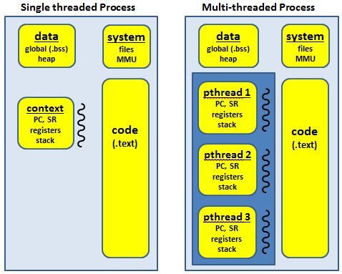
Multi-threading

Slide 19
Task Control Block (tcb)
State = { NEW, READY, RUNNING, BLOCKED, EXIT
Priority = { LOW, MED, HIGH, VERY_HIGH, HIGHEST }
// task control block
typedef struct // task control block
{
char* name; // task name
int (*task)(int,char**); // task address
int state; // task state (P2)
int priority; // task priority (P2)
int argc; // task argument count (P1)
char** argv; // task argument pointers (P1)
int signal; // task signals (P1)
// void (*sigContHandler)(void); // task mySIGCONT handler
void (*sigIntHandler)(void); // task mySIGINT handler
// void (*sigKillHandler)(void); // task mySIGKILL handler
// void (*sigTermHandler)(void); // task mySIGTERM handler
// void (*sigTstpHandler)(void); // task mySIGTSTP handler
TID parent; // task parent
int RPT; // task root page table (P4)
int cdir; // task directory (P6)
Semaphore *event; // blocked task semaphore (P2)
void* stack; // task stack (P1)
jmp_buf context; // task context pointer (P1)
} TCB;
Pending semaphore when blocked.

Slide 20
Types of Threads
A thread consists of:
a thread execution state (Running, Ready, etc.)
a context (program counter, register set.)
an execution stack.
some per-tread static storage for local variables.
access to the memory and resources of its process (shared with all other threads in that process.)
OS resources (open files, signals, etc.)
Thus, all of the threads of a process share the state and resources of the parent process (memory space and code section.)
There are two types of threads:
User-space (ULT) and
Kernel-space (KLT).

Slide 21
User-Level Threads
User-level threads avoid the kernel and are managed by the process.
Often this is called "cooperative multitasking" where the task defines a set of routines that get "switched to" by manipulating the stack pointer.
Typically each thread "gives-up" the CPU by calling an explicit switch, sending a signal or doing an operation that involves the switcher.
A timer signal can force switching.
User threads typically can switch faster than kernel threads [however, Linux kernel threads' switching is actually pretty close in performance].

Slide 22
User-Level Threads
Disadvantages.
User-space threads have a problem that a single thread can monopolize the timeslice thus starving the other threads within the task.
Also, it has no way of taking advantage of SMPs (Symmetric MultiProcessor systems, e.g. dual-/quad-Pentiums).
Lastly, when a thread becomes I/O blocked, all other threads within the task lose the timeslice as well.
Solutions/work arounds.
Timeslice monopolization can be controlled with an external monitor that uses its own clock tick.
Some SMPs can support user-space multithreading by firing up tasks on specified CPUs then starting the threads from there [this form of SMP threading seems tenuous, at best].
Some libraries solve the I/O blocking problem with special wrappers over system calls, or the task can be written for nonblocking I/O.

Slide 23
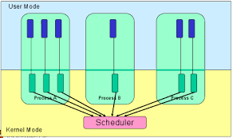
Kernel-Level Threads
KLTs often are implemented in the kernel using several tables (each task gets a table of threads).
The kernel schedules each thread within the timeslice of each process.
There is a little more overhead with mode switching from user to kernel mode because of loading of larger contexts, but initial performance measures indicate a negligible increase in time.
Advantages.
Since the clocktick will determine the switching times, a task is less likely to hog the timeslice from the other threads within the task.
I/O blocking is not a problem.
If properly coded, the process automatically can take advantage of SMPs and will run incrementally faster with each added CPU.

Slide 24
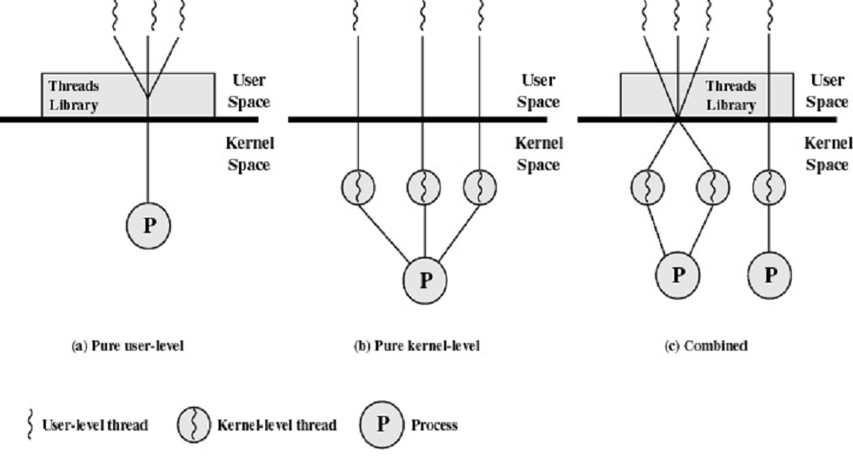
User-Level and Kernel-Level Threads

Slide 25


Be Safe

